Slide 1
CompTIA Security+ Guide to Network Security Fundamentals, Sixth Edition
Chapter 6
Network Security Devices, Design, and Technology

Slide 2
Objectives
6.1 List the different types of network security devices and how they can be used
6.2 Describe secure network architectures
6.3 Explain how network technologies can enhance security

Slide 3
Security Through Network Devices
Security can be achieved through using the security features found in standard networking devices
As well as hardware designed primarily for security

Slide 4
Standard Network Devices
Standard network devices can be classified by the O S I layer at which they function
O S I model breaks networking steps into seven layers
Each layer has different networking tasks
Each layer cooperates with adjacent layers
Security functions of network devices can provide a degree of network security
Improperly configured standard network devices can introduce vulnerabilities
Some devices include:
Bridges, switches, routers, load balancers, and proxies

Slide 5
Bridges (1 of 2)
Bridges
Hardware device or software that is used to join two separate computer networks to enable communication between them
Can connect two local area networks (LANs) or two network segments (subnets)
Operate at the Data Link layer (Layer 2) so all networks or segments connected must use the same Layer 2 protocol (such as Ethernet)
Most O Ss allow for a software bridge to connect two network segments
Creating a software bridge could create a security vulnerability

Slide 6
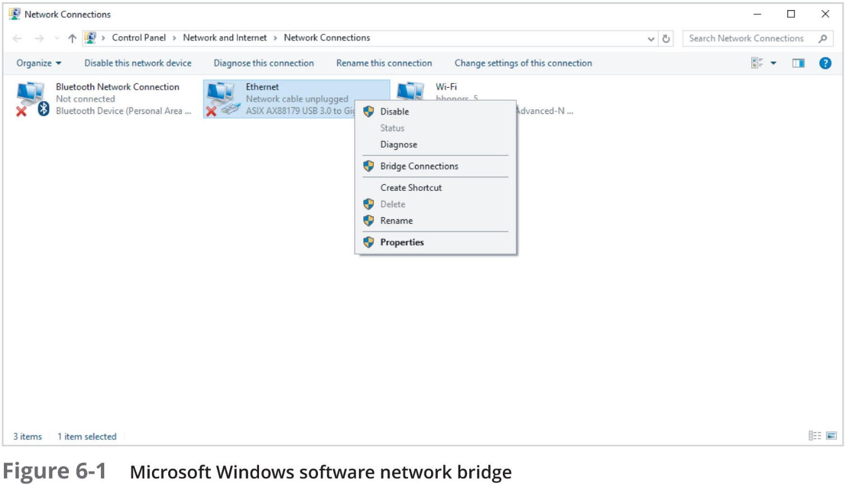
Bridges (2 of 2)

Slide 7
Switches (1 of 3)
Switches
A device that connects network hosts intelligently
Can learn which device is connected to each of its ports
Examines the M A C address of frames that it receives and associates its port with the M A C address of the device connected to that port
Stores addresses in a M A C address table
Forwards frames intended for a specific device (unicast) instead of sending it out all ports (broadcast)
Important for switches to be properly configured to provide a high degree of security
Proper configuration includes loop prevention, and providing a flood guard

Slide 8
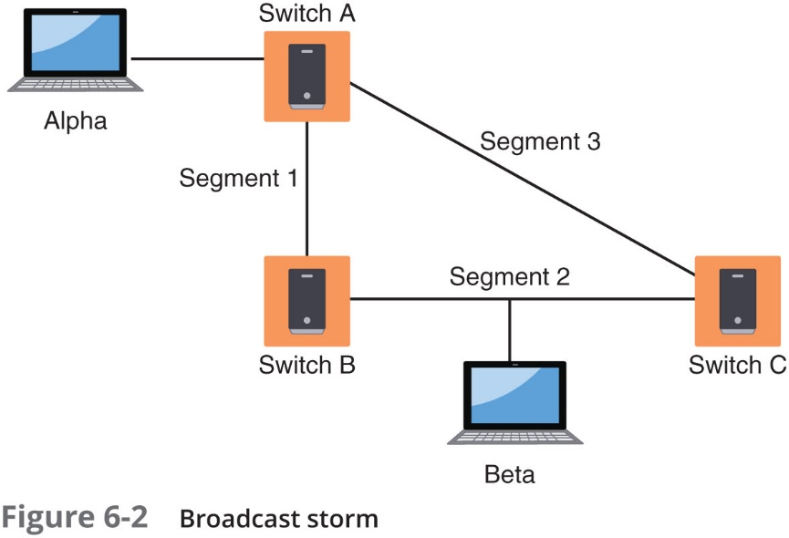
Switches (2 of 3)

Slide 9
Switches (3 of 3)
Flood Guard
A threat agent may attempt a M A C flooding attack by overflowing the switch with Ethernet frames that have been spoofed so that each frame contains a different source M A C address
The defense against a M A C flooding attack is a flood guard (port security)
Switches that support port security can be configured to limit the number of M A C addresses that can be learned on ports

Slide 10
Routers
Routers
Forward packets across different computer networks
Operate at Network Layer (Layer 3)
Can be set to filter out specific types of network traffic by using an Access Control List (A C L)
Can also be used to limit traffic entering the network from unapproved networks
Load balancers
Help evenly distribute work across a network
Allocate requests among multiple devices

Slide 11
Load Balancers (1 of 2)
Load balancers
Help evenly distribute work across a network
Allocate requests among multiple devices
Advantages of load-balancing technology
Reduces probability of overloading a single server
Optimizes bandwidth of network computers

Slide 12
Load Balancers (2 of 2)
Load balancing is achieved through software or hardware device (load balancer)
Load balancers are grouped into two categories:
Layer 4 load balancers - act upon data found in Network and Transport layer protocols
Layer 7 load balancers - distribute requests based on data found in Application layer protocols
Different scheduling protocols used in load balancers:
Round-robin
Affinity
Other

Slide 13
Proxies (1 of 3)
Proxies - there are several types of proxies used in computer networking
Forward proxy - a computer or an application program that intercepts user requests from the internal network and processes that request on behalf of the user
Application/multipurpose proxy - a special proxy server that “knows” the application protocols that it supports
Reverse proxy – routes requests coming from an external network to the correct internal server
Transparent proxy – does not require any configuration on the user’s computer

Slide 14
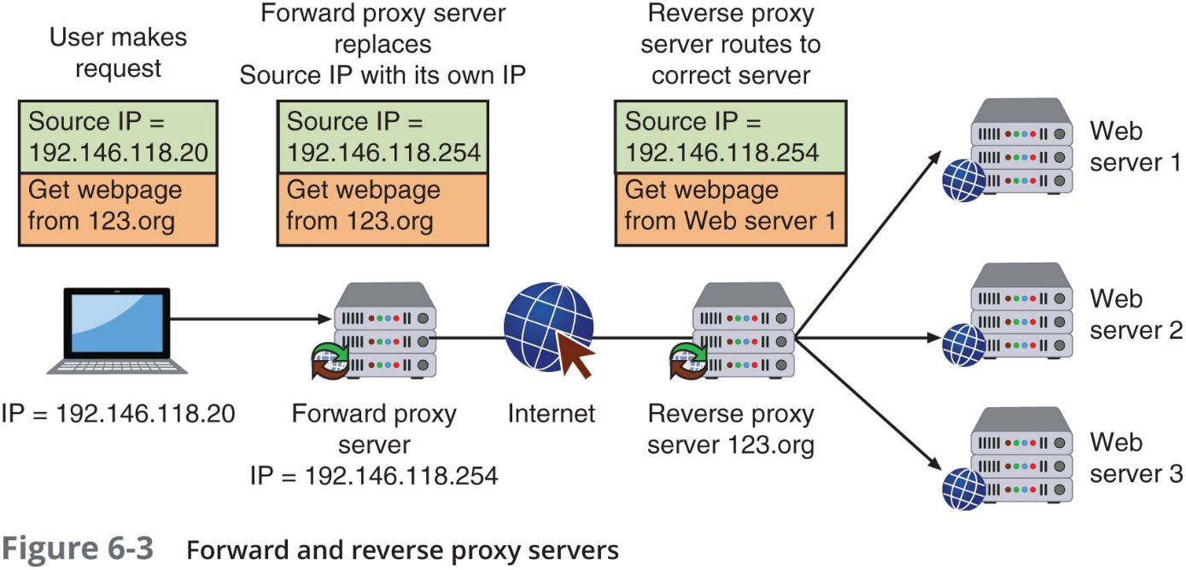
Proxies (2 of 3)

Slide 15
Proxies (3 of 3)
Advantages of proxy servers:
Increased speed
Reduced costs
Improved management
Stronger security

Slide 16
Network Security Hardware
Specifically designed security hardware devices
Provide greater protection than standard networking devices
Firewalls
Can be software-based or hardware-based
Both types inspect packets and either accept or deny entry
Hardware firewalls tend to be more expensive and more difficult to configure and manage
Software firewalls running on a device provide protection to that device only
All modern OSs include a software firewall, usually called a host-based firewall

Slide 17
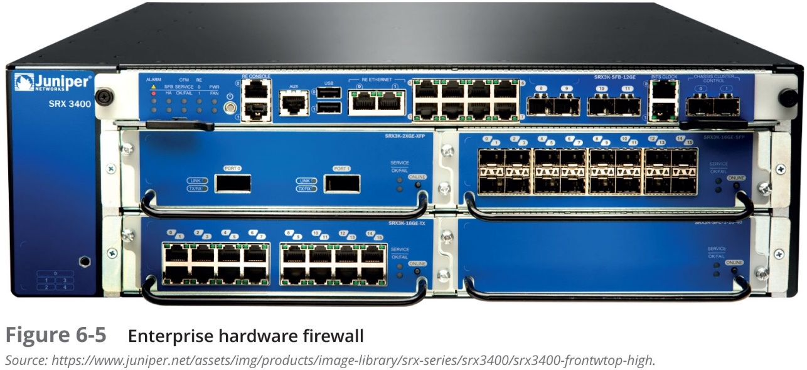
Firewalls (1 of 3)

Slide 18
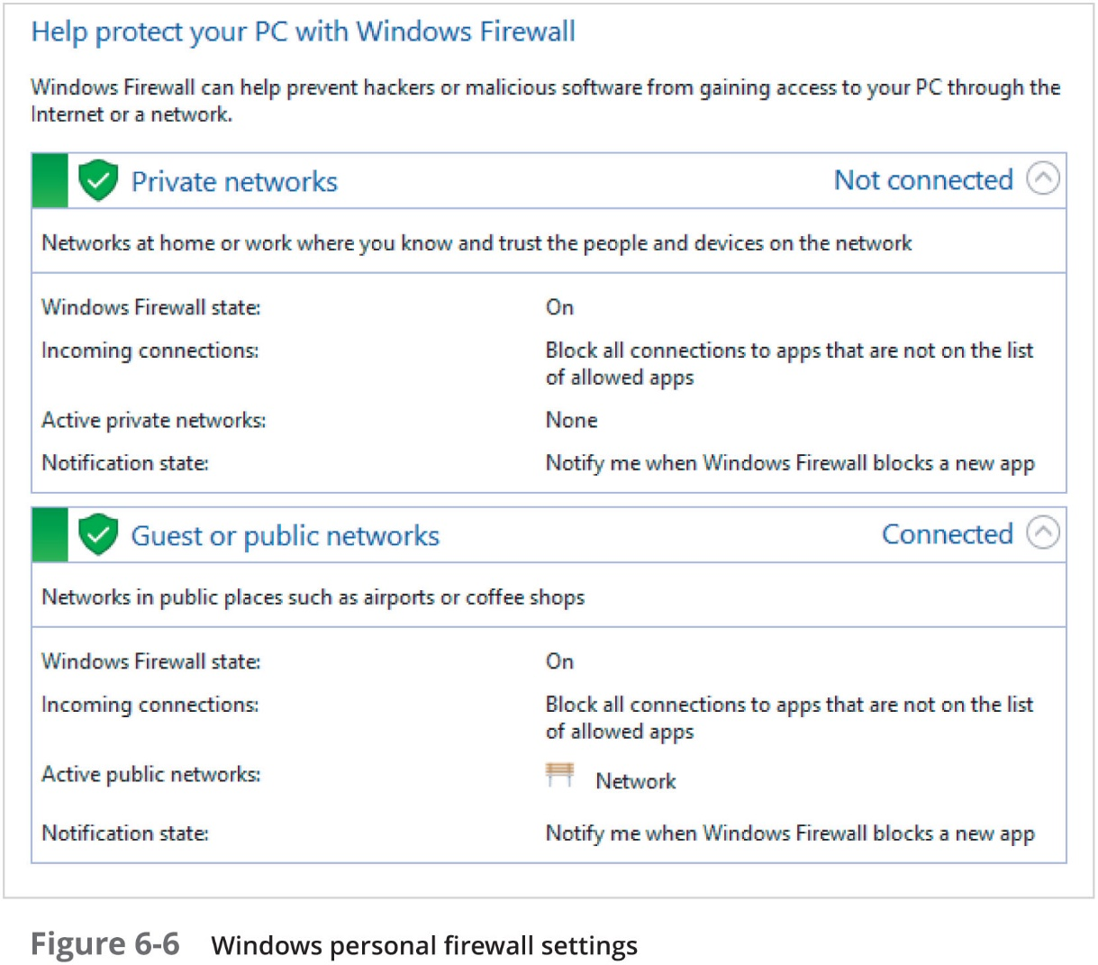
Firewalls (2 of 3)

Slide 19
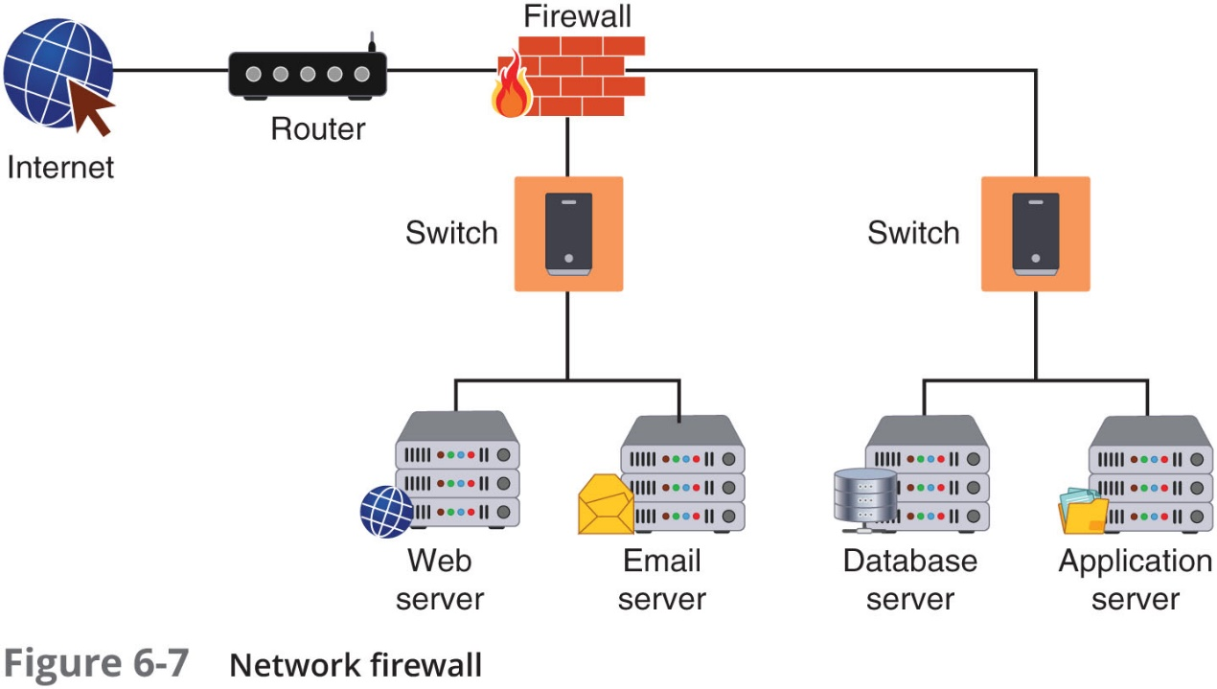
Firewalls (3 of 3)

Slide 20
Network-Based Firewalls (1 of 2)
Methods of firewall packet filtering
Stateless packet filtering
Inspects incoming packet and permits or denies based on conditions set by administrator
Stateful packet filtering
Keeps a record of the state of a connection
Makes decisions based on the connection and conditions
Firewall actions on a packet
Allow (let packet pass through)
Drop (prevent the packet from passing into the network and send no response to sender)
Reject (prevent the packet from passing into the network but send a message to the sender)

Slide 21
Network-Based Firewalls (2 of 2)
Rule-based firewalls
Use a set of individual instructions to control actions
Each rule is a separate instruction processed in sequence telling the firewall what action to take
Rules are stored together in one or more text file(s) that are read when the firewall starts
Rule-based systems are static in nature
Cannot do anything other than what they have been configured to do

Slide 22
Application-Based Firewalls
Application-Aware Firewalls
Operate at a higher level by identifying applications that send packets through the firewall and make decisions about actions to take
Applications can be identified by application-based firewalls through:
Predefined application signatures
Header inspection
Payload analysis
Web application firewall
Special type of application-aware firewall that looks deeply into packets that carry H T T P traffic
Can block specific sites or specific types of H T T P traffic

Slide 23
Virtual Private Network (V P N) Concentrator (1 of 2)
Virtual private network (V P N) - enables authorized users to use an unsecured public network as if it were a secure private network
All data transmitted between remote device and network is encrypted
Types of V P Ns
Remote-access V P N - a user-to-LAN connection
Site-to-site - multiple sites can connect to other sites over the Internet
Always-on V P Ns – allow the user to always stay connected
Endpoints
The end of the tunnel between V P N devices
May be software on local computer or a V P N concentrator

Slide 24
Virtual Private Network (V P N) Concentrator (2 of 2)
V P N concentrator - a dedicated hardware device that aggregates hundreds or thousands of V P N connections
When using a V P N, there are two options:
All traffic is sent to the V P N concentrator and protected (called a full tunnel)
Only some traffic is routed over the secure V P N, while other traffic directly accesses the Internet (called split tunneling)

Slide 25
Mail Gateway
There are two different email systems in use:
One system uses two TCP/I P protocols to send and receive messages: Simple Mail Transfer Protocol (SMTP) and Post Office Protocol (POP/POP3)
IMAP (Internet Message Access Protocol) is a more recent and advanced email system
With IMAP, email remains on the email server and is not downloaded to a user’s computer
Mail gateway
Monitors emails for unwanted content and prevents these messages from being delivered
For inbound emails, a mail gateway can search for various types of:
Malware, spam, and phishing attacks
For outbound email, a mail gateway can detect and block the transmission of sensitive data

Slide 26
Network Intrusion Detection and Prevention (1 of 5)
Intrusion detection system (IDS)
Can detect attack as it occurs
Inline IDS
Connected directly to the network and monitors the flow of data as it occurs
Passive IDS
Connected to a port on a switch, which receives a copy of network traffic
IDS systems can be managed:
In-band – through the network itself by using network protocols and tools
Out-of-band – using an independent and dedicated channel to reach the device

Slide 27
Network Intrusion Detection and Prevention (2 of 5)
Function | Inline | Passive
Connection | Directly to network | Connected to port on switch
Traffic flow | Routed through the device | Receives copy of traffic
Blocking | Can block attacks | Cannot block attacks
Detection error | May disrupt service | May cause false alarm

Slide 28
Network Intrusion Detection and Prevention (3 of 5)
Monitoring methodologies
Anomaly-based monitoring
Compares current detected behavior with baseline
Signature-based monitoring
Looks for well-known attack signature patterns
Behavior-based monitoring
Detects abnormal actions by processes or programs
Alerts user who decides whether to allow or block activity
Heuristic monitoring
Uses experience-based techniques

Slide 29
Network Intrusion Detection and Prevention (4 of 5)
Types of IDS- two basic types if IDS exist
Host intrusion detection system (HIDS)
A software-based application that can detect an attack as it occurs
Installed on each system needing protection
Monitors:
System calls and file system access
Can recognize unauthorized Registry modification
Host input and output communications
Detects anomalous activity
Disadvantages of HIDS
Cannot monitor network traffic that does not reach local system
All log data is stored locally
Resource-intensive and can slow system

Slide 30
Network Intrusion Detection and Prevention (5 of 5)
Network intrusion detection system (NIDS)
Watches for attacks on the network
NIDS sensors installed on firewalls and routers:
Gather information and report back to central device
NIDS can sound an alarm and log events
Application-aware IDS
A specialized IDS
Uses “contextual knowledge” in real time
It can know the version of the O S or which application is running
As well as what vulnerabilities are present in the systems being protected

Slide 31
Intrusion Prevention Systems (I P Ss)
Intrusion Prevention System (I P S)
Monitors network traffic to immediately block a malicious attack
Similar to N I D S
N I P S is located “in line” on the firewall
Allows the N I P S to more quickly take action to block an attack
Application-aware I P S
Knows which applications are running as well as the underlying O S

Slide 32
Security and Information Event Management (S I E M) (1 of 3)
Security and Information Event Management (S I E M) product
A S I E M consolidates real-time monitoring and management of security information
Analyzes and reports on security events
A S I E M product can be:
A separate device
Software that runs on a computer
A service that is provided by a third party

Slide 33
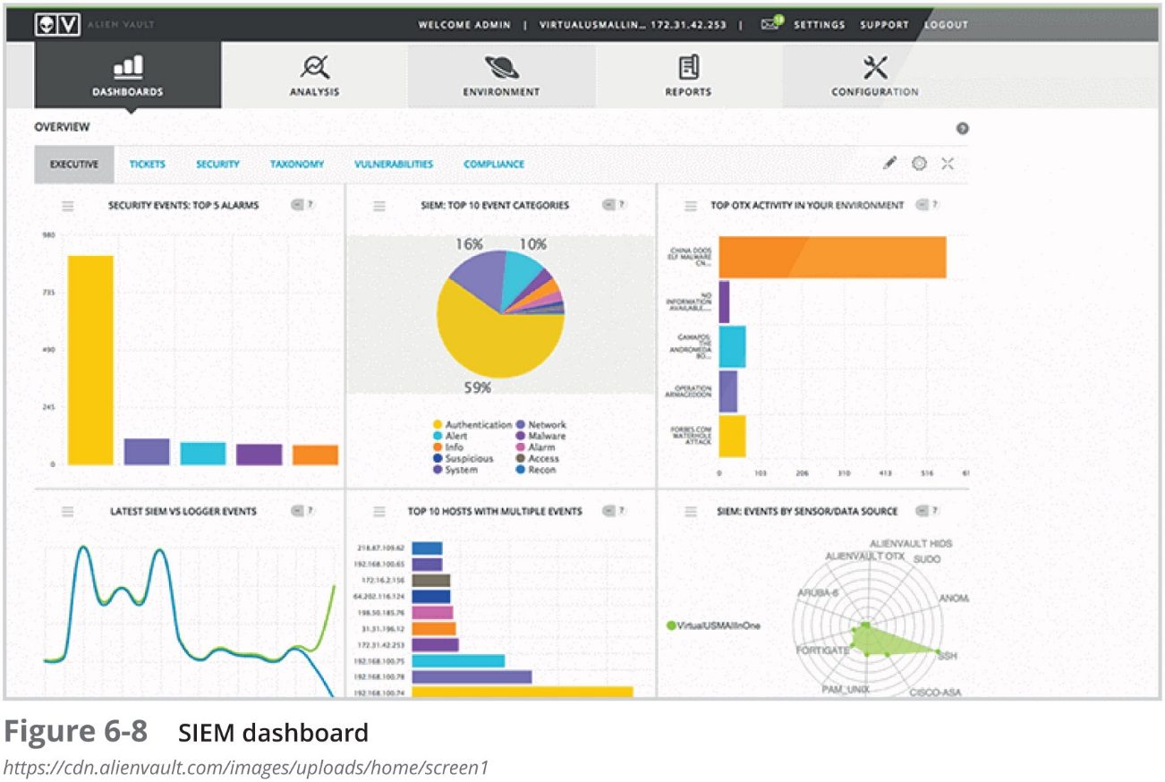
Security and Information Event Management (S I E M) (2 of 3)

Slide 34
Security and Information Event Management (S I E M) (3 of 3)
A S I E M typically has the following features:
Aggregation
Correlation
Automated alerting and triggers
Time synchronization
Event duplication
S I E M logs

Slide 35
Other Network Security Hardware Devices (1 of 2)
Name | Description | Comments
Hardware security module | A dedicated cryptographic processor that provides protection for cryptographic keys | A tamper-resistant device that can securely manage, process, and store cryptographic keys
S S L decryptor | A separate device that decrypts S S L traffic | Helps reduce performance degradation and eliminates the need to have multiple decryption licenses spread across multiple devices
SS L/T L S accelerator | A separate hardware card that inserts into a web server that contains one or more co-processors to handle S S L/T L S processing | Used to accelerate the computationally intensive initial SSL connection handshake, during which keys are generated for symmetric encryption using 3 D E S or A E S
Media gateway | A device that converts media data from one format to another | Sometimes called a softswitch, converts data in audio or video format

Slide 36
Other Network Security Hardware Devices (2 of 2)
Name | Description | Comments
Unified Threat Management (U T M) | Integrated device that combines several security functions | Multipurpose security appliance that provides an array of security functions, such as antispam, antiphishing, antispyware, encryption, intrusion protection, and web filtering
Internet content filter | Monitors Internet traffic and block access to preselected websites and files | Restricts unapproved websites based on U R L or by searching for and matching keywords such as sex or hate as well as looking for malware
Web security gateway | Blocks malicious content in real time as it appears without first knowing the U R L of a dangerous site | Enables a higher level of defense by examining the content through application-level filtering

Slide 37
Security Through Network Architecture
The design of a network can provide a secure foundation for resisting attackers
Elements of a secure network architectural design include:
Creating security zones
Using network segregation

Slide 38
Security Zones
A secure approach is to create zones to partition the network
So that certain users may enter one zone while access is prohibited to other users
The most common security zones:
Demilitarized zones
Using network address translation to create zones

Slide 39
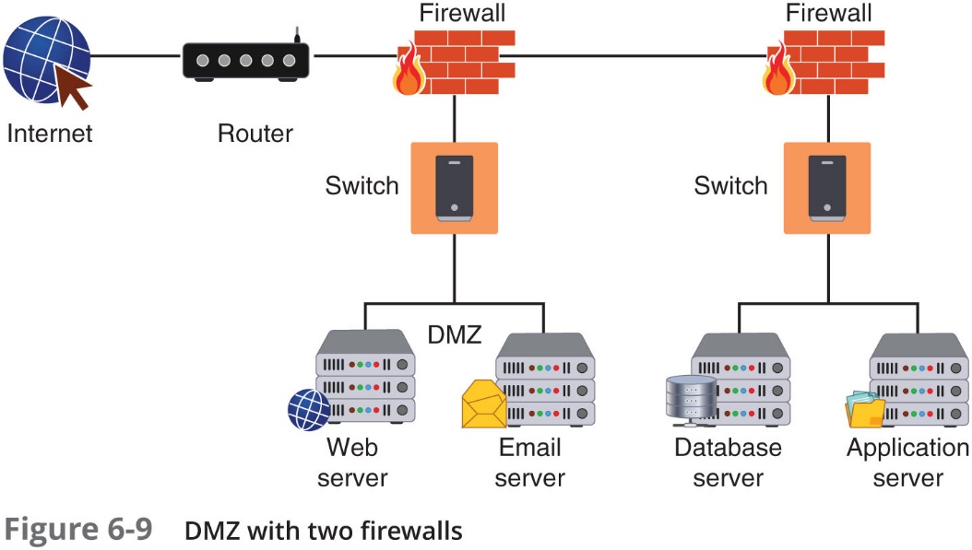
Demilitarized Zone (D M Z)
D M Z - a separate network located outside secure network perimeter
Untrusted outside users can access D M Z but not secure network

Slide 40
Network Address Translation (N A T) (1 of 2)
Network address translation (N A T)
Allows private I P addresses to be used on the public Internet
Replaces private I P address with public address
Advantage of N A T
Masks I P addresses of internal devices
An attacker who captures the packet on the Internet cannot determine the actual I P address of sender

Slide 41
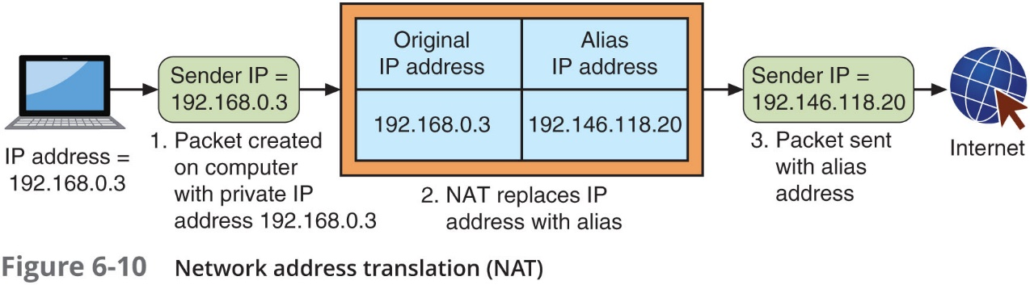
Network Address Translation (N A T) (2 of 2)

Slide 42
Other Zones
Name | Description | Security benefits
Intranet | A private network that belongs to an organization that can only be accessed by approved internal users | Closed to the outside public, thus data is less vulnerable to external threat actors
Extranet | A private network that can be access by authorized external customers, vendors, and partners | Can provide enhanced security for outside users compared to a publicly accessible website
Guest network | A separate open network that anyone can access without prior authorization | Permits access to general network resources like web surfing without using the secure network

Slide 43
Network Segregation (1 of 2)
Physical network segregation
Isolates the network so that it is not accessible by outsiders
Air gap
The absence of any type of connection between devices
In this case the secure network and another network
Networks can be segmented using switches to divide the network into a hierarchy
Core switches reside at the top of the hierarchy and carry traffic between switches
Workgroup switches are connected directly to the devices on the network

Slide 44
Network Segregation (2 of 2)
Virtual LAN (V LAN)
Allow scattered users to be logically grouped together
Even if attached to different switches
Can isolate sensitive data to V LAN members
Communication on a V LAN
If connected to same switch, switch handles packet transfer
A special “tagging” protocol is used for communicating between switches

Slide 45
Security Through Network Technologies
Two technologies that can help secure a network:
Network access control
Data loss prevention

Slide 46
Network Access Control (N A C) (1 of 3)
N A C
Examines the current state of a system or network device before it can connect to the network
Any device that does not meet a specified set of criteria can connect only to a “quarantine” network where the security deficiencies are corrected
Goal of N A C
To prevent computers with suboptimal security from potentially infecting other computers through the network

Slide 47
Network Access Control (N A C) (2 of 3)
N A C uses software “agents” to gather information and report back (host agent health checks)
An agent may be a:
Permanent N A C agent
Dissolvable N A C agent – disappears after reporting information to the N A C
N A C technology can be embedded within a Microsoft Windows Active Directory domain controller
N A C uses A D to scan the device (called agentless N A C)

Slide 48
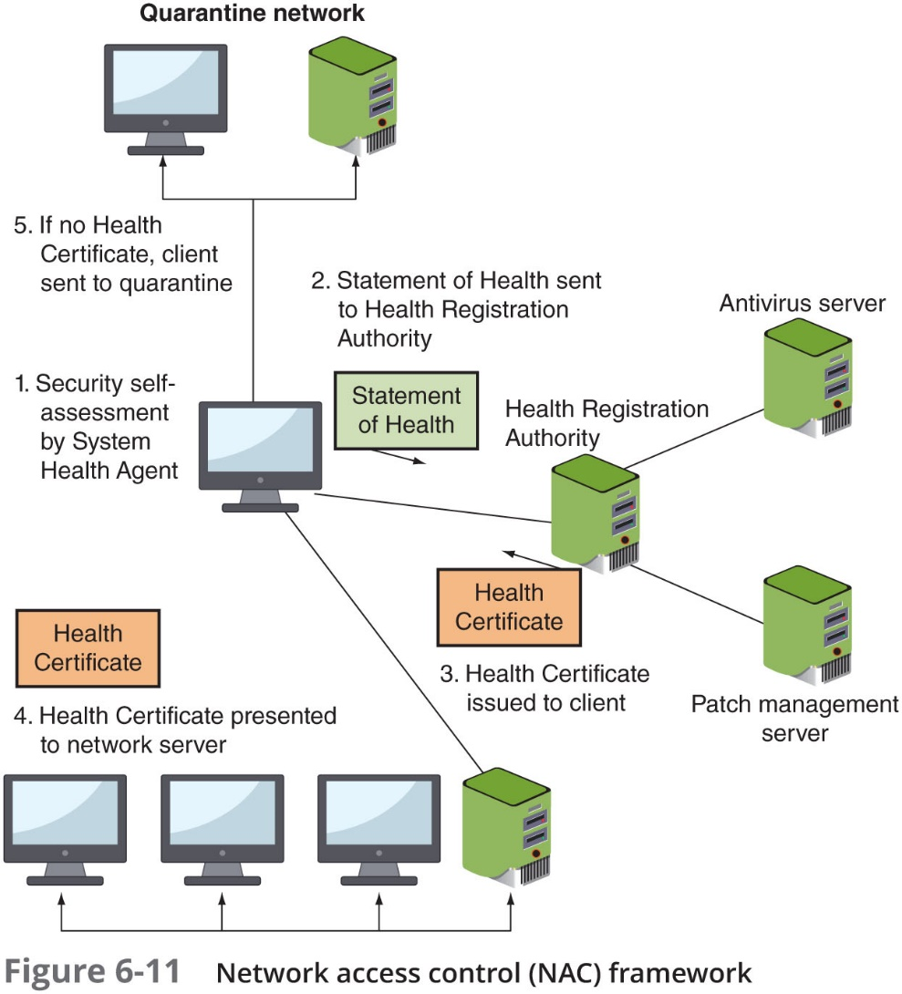
Network Access Control (N A C) (3 of 3)

Slide 49
Data Loss Prevention (D L P) (1 of 3)
D L P
A system of security tools that is used to recognize and identify data that is critical to the organization
Ensures that it is protected
Two common uses of D L P
Monitoring emails through a mail gateway
Blocking the copying of files to a U S B flash drive (U S B blocking)
Most D L P systems use content inspection
Defined as a security analysis of the transaction within its approved context

Slide 50
Data Loss Prevention (D L P) (2 of 3)
Content inspection looks at not only the security level of data, but also:
Who is requesting it
Where the data is stored
When it was requested
Where it is going
Three types of D L P sensors:
D L P network sensors
D L P storage sensors
D L P agent sensors

Slide 51
Data Loss Prevention (D L P) (3 of 3)
When a policy violation is detected by the D L P agent
It is reported back to the D L P server
Different actions can be taken:
Block the data
Redirect it to an individual who can examine the request
Quarantine the data until later
Alert a supervisor of the request

Slide 52
Review Questions
Which of these would NOT be a filtering mechanism found in a firewall ACL rule?
A. source address
B. direction
C. date
D. protocol
Which function does an Internet content filter NOT perform?
A. intrusion detection
B. URL filtering
C. malware inspection
D. content inspection
Which statement about network address translation (NAT) is true?
A. It substitutes MAC addresses for IP addresses.
B. It can be stateful or stateless.
C. It can be found only on core routers.
D. It removes private addresses when the packet leaves the network.
Notes:
`

Slide 53
Chapter Summary (1 of 2)
Standard network security devices provide a degree of security
Switches, router, load balancer, and proxies
Hardware devices specifically designed for security give higher protection level
Hardware-based firewall, Web application firewall
Virtual private networks (V P Ns) use an unsecured public network and encryption to provide security
A mail gateway monitors emails for unwanted content and prevents these messages from being delivered
An intrusion detection system (I D S) is designed to detect an attack as it occurs

Slide 54
Chapter Summary (2 of 2)
A Security and Information Event Management (S I E M) product consolidates real-time monitoring and management of security information along with an analysis and reporting of security events
Other network security hardware devices include:
Hardware security modules, S S L decryptors, S S L/T L S accelerators, media gateways, U T M products, Internet content filters, and web security gateways
Methods for designing a secure network
Demilitarized zones
Virtual LANs
Network technologies can help secure a network
Network access control (N A C)

